Slide 1



Paradise
SIGHT forward

Slide 2

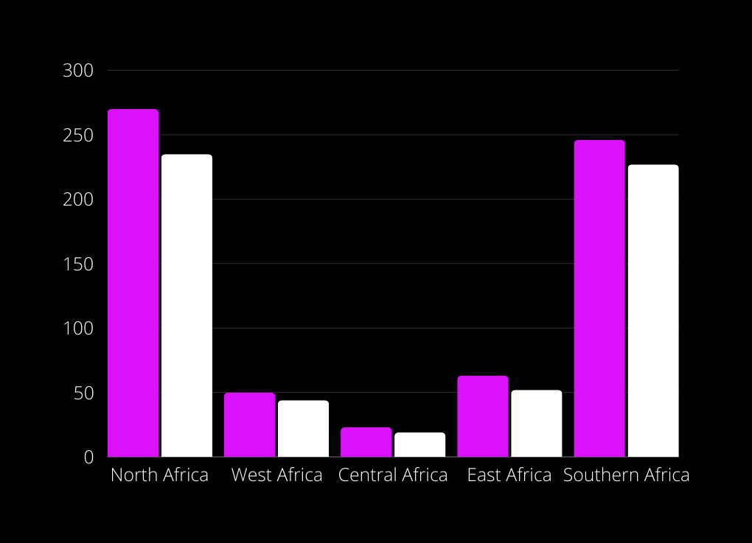
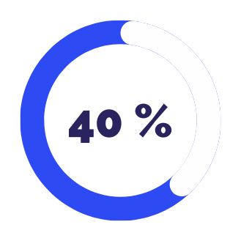
our problematic
TWH
CONTRYS
Out of a total African population of 1.4 billion, 560 million Africans do not have access to electricity.

Slide 3
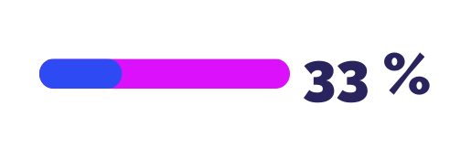
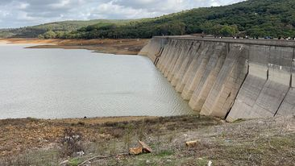
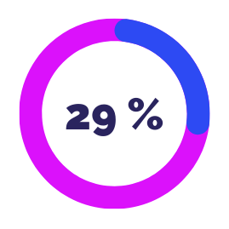
our problematic
One in three African citizens is affected by a lack of water.
400 million people in Africa do not have access to basic clean water.
Bani Matir Dam Tunisia

Slide 4
our solutions

Slide 5
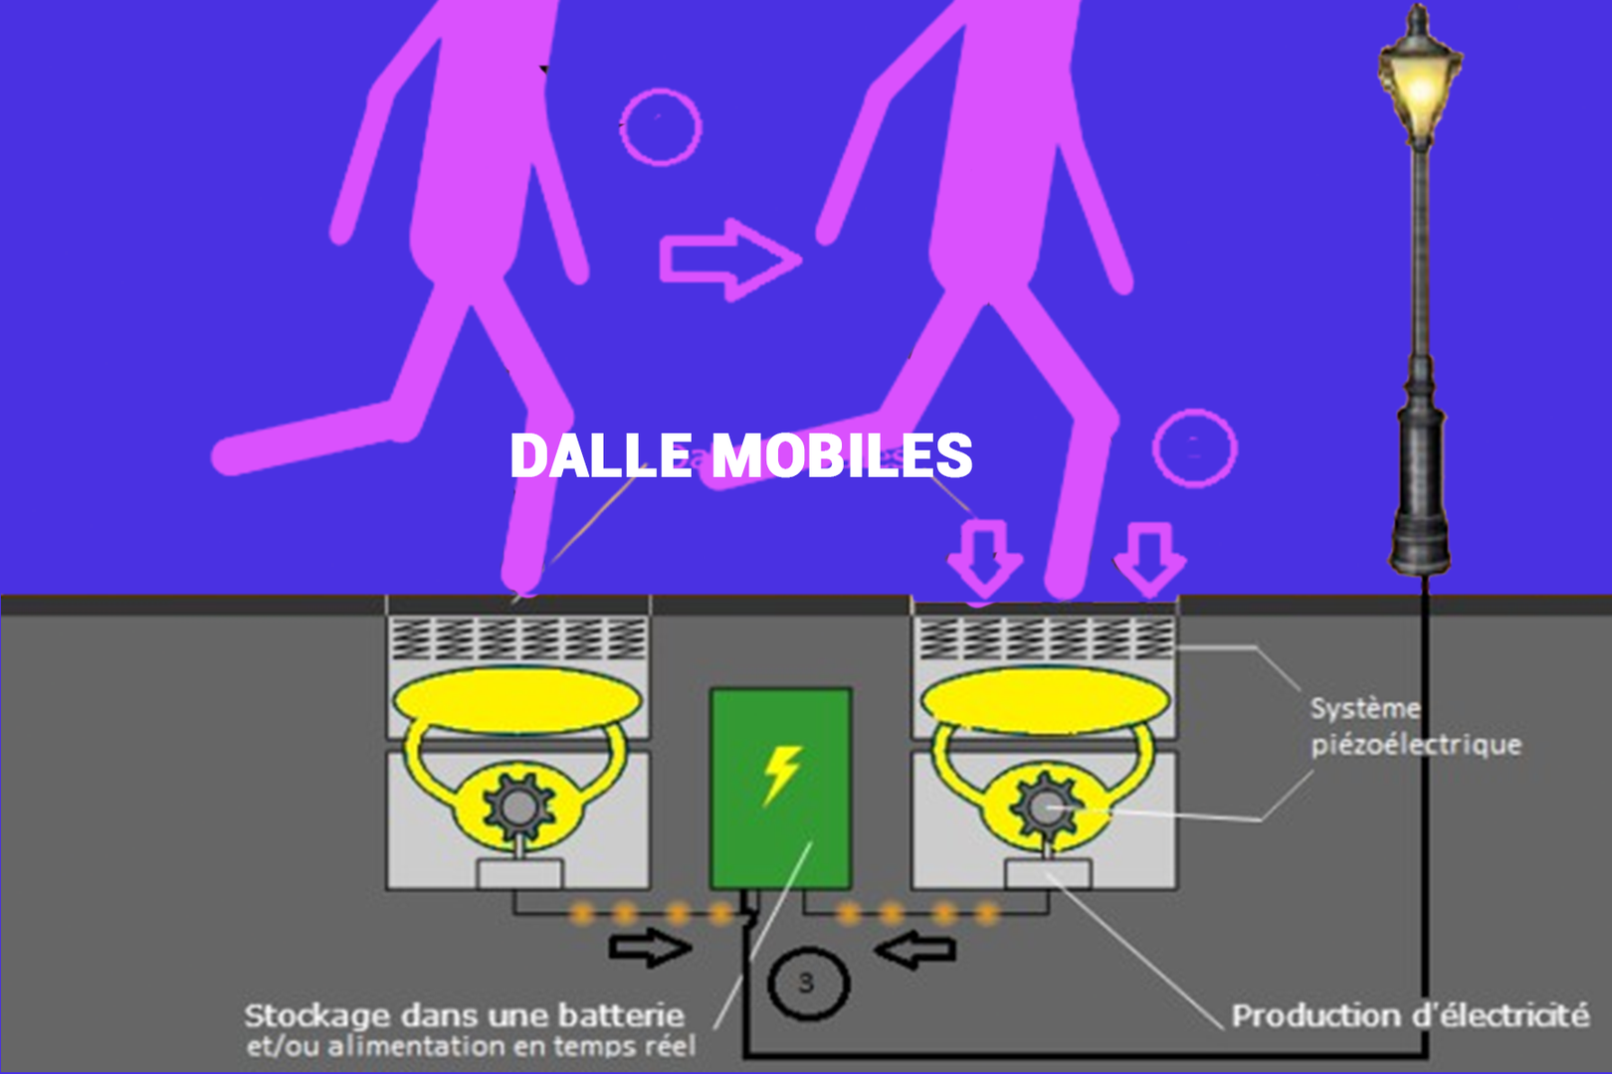
Piezoelectric flooring

Slide 6
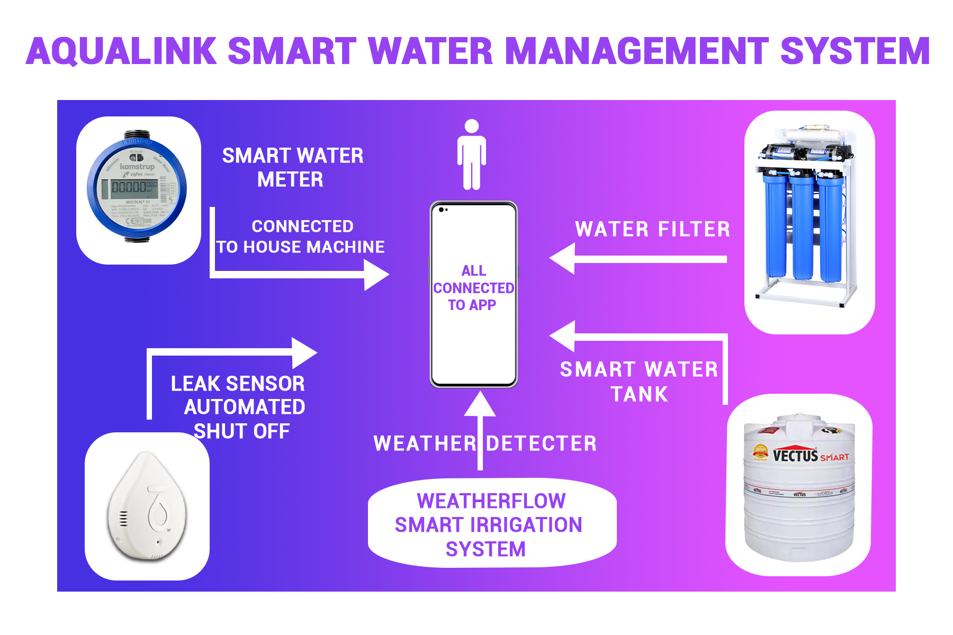

Slide 7



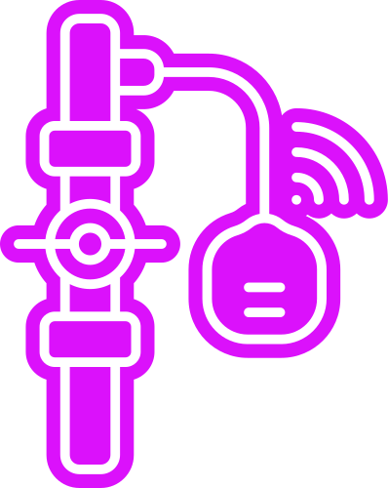

Architecture of our water systems
A smart water meter measures the water consumption of each water-using device.
A leak detection sensor with automatic shut-off, designed to identify water leaks and automatically cut off the supply in case of an issue.

Slide 8





Architecture of our water systems
our innovative water recycling system has been implemented, involving multiple steps to optimize water usage. When water is used in the shower and sink, it passes through an intelligent filtering device. This smart filter is designed to remove impurities and ensure that the recycled water is of high quality.
After being filtered, the water is directed to an intelligent tank dedicated to storage. This tank is equipped with level sensors to monitor the quantity of stored water, allowing for precise management of the recycled water reserve.
In the event of a water shortage, the intelligent system is programmed to automatically route the stored water to the necessary points of use, ensuring a continuous supply even during temporary shortages.
water filter
smart water tank

Slide 9
our value proposition
A comprehensive and integrated solution designed for the efficient management of water and electricity, with a particular emphasis on sustainability and intelligent resource management.

Slide 10
Our Bussiness Model Canva
IEEE SIGHT
STEG
SONEDE
RINA - LAB21
Our Mobile Application Development
Implement piezoelectric devices and other electricity technologies.
implement intelligent water systems
A comprehensive and integrated solution designed for the efficient management of water and electricity, with a particular emphasis on sustainability and intelligent resource management.
Indirect communication
Automated service
event
word of mouth
African Community:
homeowner
stadium owner
government
Partners :
Key activities :
Value proposition :
Customer relationship:
Customer segment :
Mobile Application
delivery and installation in situ
social media
solar panels
rainwater harvesting
Channels:
Existing Alternatives
intelligent water systems
Piezoelectric flooring
Mobile Application
Key resources :
Cost structure:
Revenue structure:
Cost Mobile Application
Cost Piezoelectric flooring
cost intelligent water systems
buy Piezoelectric flooring and intelligent water systems
to provide Piezoelectric flooring and intelligent water systems for free but charge fees monthly through an app

Slide 11


Our COMPETITORS
Off Grid Electric
Fenix International
Water Access Rwanda
Our Startup
BBOXX
Renewable power
Reliable access to clean water
Water and electricity management
Independent On Weather Conditions

Slide 12



1.4 billion
TAM
TOTAL ADDRESSABLE MARKET
560 million
SAM
SERVICEABLE ACCESSIBLE MARKET
100 million
SOM
SERVICEABLE AVAILABLE MARKET

Slide 13


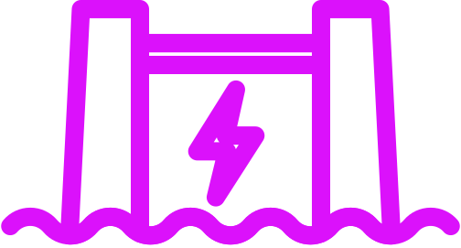
RoadMap
Implementing smart electricity measuring sensors connected to our dedicated mobile application to optimize electricity consumption management.
Integrate Piezoelectric flooring across all high-traffic areas.
Generate electricity from water turbines through the agitation of water within the hydraulic infrastructure.

Slide 14
THANK YOU

